Slide 1

GAMES SALES analysis
RevoU Data Analytics Mini Course
By Aqila Lutfiyanida

Slide 2
Table of content
Dataset
Problem Statement
Data Cleaning
Data Visualization & Insight

Slide 3
dataset
Context: Gaming industry is an interesting field to explore, it would be fun knowing who is the most popular publishers, developers and which games are the most popular.
Dataset: Games Sales
Content Data:
Name : Name of the game
Sales : Sales of the game in Millions
Series : Series of the game
Release : Release date of the game
Genre : Genre of the game
Developer : Developer of the game
Publisher : Publisher of the game

Slide 4
Problem statement
01
04
Which game is the oldest and the newest of the games?
Which series is the most sales?
02
05
Which series have the most games?
Which publisher published most of the games?
03
Which developer developed most of the games?

Slide 5



Data cleaning
Drop duplicates
Handle missing values
change data type
There are 36 missing values in the Series feature. These missing values fill 20% of the data, so can't be deleted because there are quite risky. The blank values in the Serores are probably because the games don’t have a series, so I just left them blank.
There are two duplicates data that need to be removed.
The Release data type in the dataset is still an object, so I changed it to datetime.

Slide 6
Data visualization and insight

Slide 7


The oldest and the newest of the games
The Oldest Game
The oldest game is Hydlide which was released on December 1, 1984 and the newest game is Valheim which was released on February 1, 2021.
The Newest Game

Slide 8
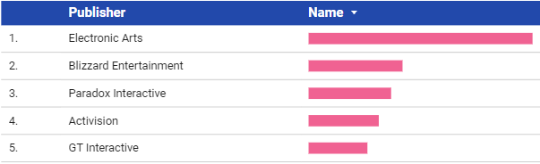
Top 5 Publisher Published Most of The Games
The chart shows that Electronic Arts publishes 19 games. This means that Electronic Arts is the publisher that publishes the most games (10.9% out of all the games).

Slide 9
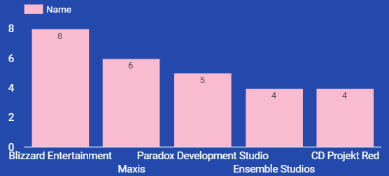
Top 5 developer developed Most of The Games
Blizzard Entertainment develops the most games from other developers, which are 8 games.

Slide 10
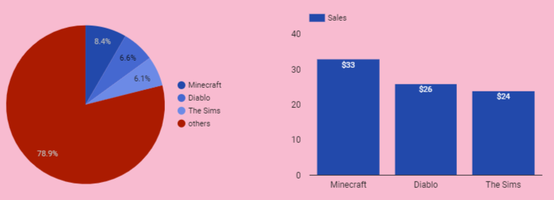
Top 3 best selling series
Based on the chart of the top 3 best selling series, it can be seen that Minecraft generates sales of 33 million, which fulfills 8.4% of the total sales of the entire series.

Slide 11
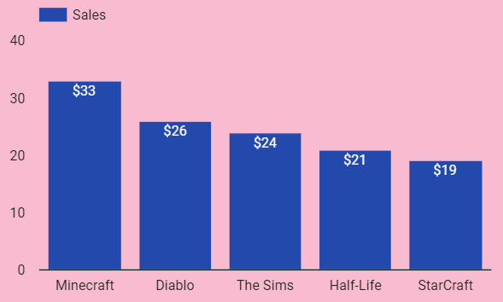
Top 5 Series Which Has The Most Games
Based on the chart of the top 3 best selling series, it can be seen that Minecraft generates sales of 33 Million which Minecraft has the most sales of other games.

Slide 12
THANK YOU
www.linkedin.com/in/aqilalutfiyanida
aqilaltf@gmail.com
Code Python: Click Here

